Slide 1

Topic: Numbers
EQ: How can we apply BIMDAS to real life situations?

Slide 2
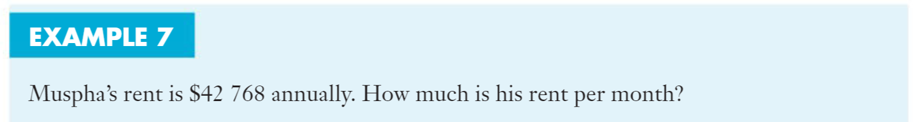
Lets do these together….

Slide 3
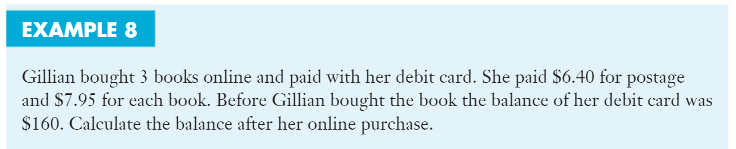
Lets do this together….

Slide 4
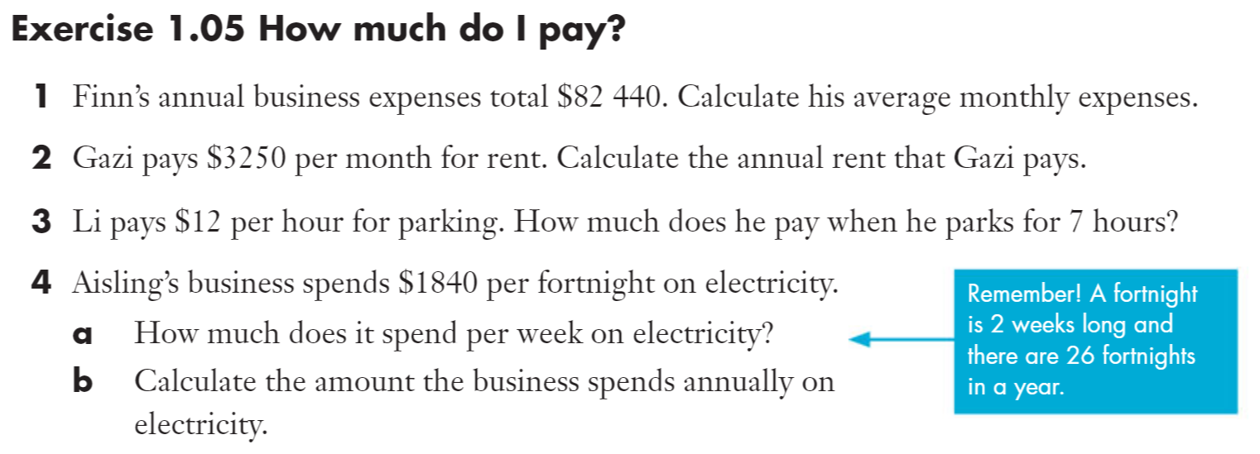
Try these on your own…

Slide 5
